Slide 1
Fast Track to F#
Point-of-sale dashboard

Slide 2
F# dashboard: Introduction

Slide 3
Developing applications in F#
F# for the domain & tools
Domain model exposed as .NET library
Plumbing implemented in C#
Testing (FsUnit, FsCheck) & tools (FAKE)
F# end-to-end
Can be useful on the UI side too
Asynchronous computations, WebSharper
http://colinbul.wordpress.com/2013/02/23/f-end-to-end

Slide 4
Web Dashboard in F#
Backend REST service in F#
Using ASP.NET WebAPI
Loads data using type providers (tomorrow)
Implements computations
Frontend web application
Standard ASP.NET MVC using C# (not much)
jQuery and Google Charts for UI
See the Demo! For testing, we use simpler…

Slide 5
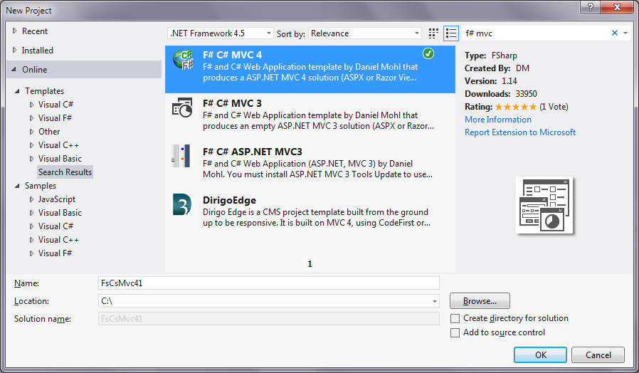
Web Dashboard in F#

Slide 6
Revisiting the domain
A sale is a list of line items (sale + tender)
Entire history is just a list of sales
type Product = Product of Name * UnitPrice
type Category = Name * Product list
type SaleLineItem = | SaleLineItem of Product * Quantity | TenderLineItem of TenderKind * Amount
type Sale = Operator option * DateTime * SaleLineItem list
type History = Sale list

Slide 7
Values available
Values loaded from XML files
Categories contain products
History contains product values
Lookup category by product using categories
Denormalization when needed
val categories : Category list
val products : Product list
val history : History

Slide 8
F# dashboard: Working with lists

Slide 9






Cutting the caterpillar
Head
Head
Head
Head
Head
End!

Slide 10
What is a list?
List is either empty or contains head & tail
Head stores the value, tail is the rest of the list
Creating lists in F#
The :: operator takes head & tail
let empty = []
let nums1 = 4::[]
let nums2 = 2::3::4::[]
let nums3 = [2; 3; 4]
let nums4 = [1 .. 10]
Nicer syntax for lists
Generating ranges

Slide 11
Functional lists in C#
List is either empty (tail) or nonempty (cons)
In C#, a class hierarchy with two classes
In F#, a discriminated union with two cases (more later)

Slide 12
Functional lists in F#
Decomposed using pattern matching
We can handle multiple cases using match
Compiler checks that we cover both cases
In the second one we get:
head – the first element of the list
tail – the rest of the list (itself a list)
match list with
| [] -> printfn "Empty list"
| head::tail -> printfn "Starting with %d" head

Slide 13
Functional & Imperative
Sum list – imperative way
Sum list – functional way
let rec sumListImperative list =
let mutable count = 0
for n in list do
count <- count + 1
count
Mutation explicit
Common mistake: let count = count + 1
Recursion explicit
let rec sumList list =
match list with
| [] -> 0
| head::tail -> head + sumList tail
Recursive call

Slide 14
Helper functions
Type Model.<…> and find what you need!
Grouping data
groupHistoryByOperator, groupAllSalesBy
Products & sales
containsProduct, findCategory, collectAllSales
General purpose
mapList, length, sumList

Slide 15
F# dashboard: Examples

Slide 16
DEMO: Products by categories

Slide 17
DEMO: Sales by operator

Slide 18
DEMO: Purchased products by category

Slide 19
DEMO: Money spent by category

